Slide 1
03
Python for (Corpus) Linguists
Python Programming for Linguists
Ingo Kleiber, 2022

Slide 2
Notebook and Solutions
We are going to solve the exercises in an (almost) empty notebook. This will, most likely, become a bit messy ….
Therefore, after this workshop, I’ll provide you (via GitHub) with a clean(er) documented solutions notebook.
Also: Have a look at the additional notebooks and exercises. Some of the problems/exercises will be discussed and solved there in more detail.

Slide 3
This Session
Concordancer
N-Grams
Frequency Analysis
Computing Basic Statistics
Basic Collocation Analysis
NLTK Stemming, Lemmatization, and WordNet
spaCy Tagging
Parsing XML
Web Scraping
Keyword Analysis
→ For some of these exercises, we will find two solutions. First, we will be using well-established libraries and tools (e.g., NLTK and spaCy). Then we are going to implement solutions in plain (more-or-less) Python in order to understand how these things work under the hood.

Slide 4
Some New Tools / Hints
Importing
Classes and Methods
List Comprehensions
Pandas and DataFrames
Enumerate
TextDirectory (Refresher)
Bonus: ftfy
There will also be some additional new things that we will explore while solving the exercises.

Slide 5
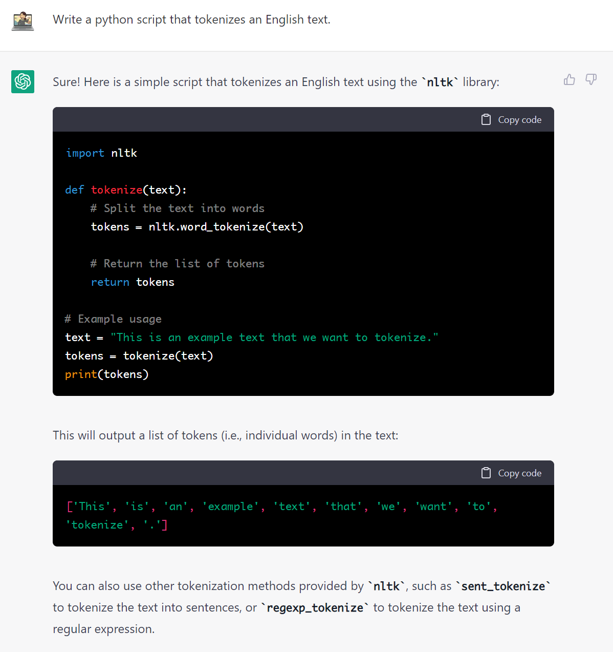
ChatGPT and Similar LLMs
Prompt
Many Large Language Models (LLMs) have the capacity to produce (working) code based on a prompt – a sort of instruction.
Most recently (as of December 2022), OpenAI’s ChatGPT has demonstrated incredible capabilities in both “writing” and “coding.”
However, keep in mind: While extremely powerful and helpful, these systems are unreliable, and there are significant legal and ethical questions still unanswered!

Slide 6
Importing
import nltk
Importing the whole library
nltk.stem.PorterStemmer()
from nltk.stem import PorterStemmer
Importing just a specific thing
PorterStemmer()
import pandas as pd
Importing the whole thing under a shorthand. This is very useful if you use something very often.
pd.DataFrame()

Slide 7
Classes and Methods
class Word():
def __init__(self, word):
self.word = word
self.length = len(word)
def reverse(self):
self.word = self.word[::-1]
Object/Instantiation
new_word = Word(‘cat‘)
new_word.reverse()
new_word.word
another_word = Word(‘dog‘)
Classes are basically “blueprints” for objects

Slide 8
List Comprehensions
numbers = [10, 20, 30]
This is equal to:
times_ten = []
for n in numbers:
times_ten.append(n * 10)
times_ten = [n * 10 for n in numbers]
List Comprehension

Slide 9
List Comprehensions
lol = [
[‘A’, 1],
[‘B’, 2],
[‘C’, 3]
]
only_first_element= [n[1] for n in lol]
[1, 2, 3]

Slide 10
Enumerate
l = [‘A’, ‘B’, ‘C’]
for index, value in enumerate(l):
print(index, value)
0 A
1 B
2 C

Slide 11
ftfy – Fixing Unicode
ftfy by Robyn Speer is an incredibly simple (to use) and useful tool for fixing problems with Unicode.
ftfy.fix_text(‘âœ” No problems‘) '✔ No problems'

Slide 12
Pandas and DataFrames
Pandas is a very powerful data analysis and manipulation tool/library. The key component are DataFrame objects which are essentially very powerful tables.
Axis 1 (rows)
Index
Columns
Document | Tokens | Sentiment
0 | 1000 | 0.2
1 | 2000 | 0.3
2 | 3000 | 0.8
3 | 3000
df = pd.DataFrame(…)
df[‘Tokens’].mean()
→ 2250.0
Axis 0 (columns)

Slide 13
TextDirectory Refresher
TextDirectory is a library that is useful when working with multiple text files in one directory. We can filter files based on various criteria and also run transformations (e.g., transforming the corpus to lowercase) on the texts.
wikipedia = textdirectory.TextDirectory(directory=‘data/wikipedia‘, autoload=True)
Load all files in the directory data/wikipedia.
wikipedia.filter_by_random_sampling(10)
Reduce the selection to 10 randomly sampled files
wikipedia.stage_transformation([‘transformation_lowercase‘])
Schedule/stage that all files (texts) are being transformed to lowercase
text = wikipedia.aggregate_to_memory()
Run the transformation and aggregate all documents into one string

Slide 14
Exercises

Slide 15
Exercise 8 – Concordancer
Write a basic concordancer that can generate concordances based on a given file and a given search term. If you want to challenge yourself, try to format the concordances in KWIC format.
RegEx-Based Approach
We will use a regular expression to find all instances of the search term as well as 25 characters before and after (left and right).
Token-Based Approach
We will tokenize the text so that we can define a window/span in terms of tokens (words) instead of characters. We will then generate a left and right window to print KWIC concordances.

Slide 16
join
Iterables are sequences that can be iterated over using, for example, a for-loop.
These include, for example, lists, sets, and strings.
We can use .join() to turn an iterable into a string.
tokens = [‘The’, ‘cat’, ‘is’, ‘grey’]
s1 = ‘ ‘.join(tokens)
The cat is grey
s2 = ‘-‘.join(tokens)
The-cat-is-grey

Slide 17
Slicing Tokens
text_tokenized = [‘the’, ‘cat’, ‘is’, ‘grey’, ‘and’, ‘likes’, ‘mice’]
search_word = ‘grey’
lr = 2
Let’s call this index (for the search term) id
0 | 1 | 2 | 3 | 4 | 5 | 6
the | cat | is | grey | and | likes | mice
text_tokenized[id – lr: id]
text_tokenized[id + 1: id + lr]
1
3
4
5

Slide 18
Exercise 9 – N-Grams
Write a function that produces all n-grams based on a given text file and an n. Hint: The NLTK provides a fairly easy solution to generating n-grams.
NLTK Approach
NLTK has an ngram method that allows us to generate n-grams very easily.
Plain Old Python
In order to generate n-grams ourselves, we need to know that the number of n-grams will be the number of tokens + 1 – n. Once we know how many n-grams there are, we can create a loop that appends the n-grams, which we get by slicing the tokenized text, to a list of n-grams.

Slide 19
Plain Old Python
n = 3
text = ’I really like Python, it is pretty awesome.’
There are six trigrams here.
6
for i in range(no_of_ngrams):
print(tokenized_text[i:i+n])
i | tokenized_text[i:i+n]
0 | [’I’, ’really’, ’like’]
1 | [’really’, ’like’, ’Python’]
2 | [’like', ’Python’, ’it’]
3 | [’Python’, ’it’, ’is’]
… | …
1 2 3
[‘I’, ‘really’, ‘like’, ‘Python’, ‘it’, ‘is’, ’pretty’, ‘awesome’]
1: 1+n
1: 4

Slide 20
Exercise 10 – Frequency Analysis
Write a script that generates a frequency table for a given text. The list should contain all types and their frequencies. Hint: Have a look at Python’s Counter capabilities.
Counter Approach
We can also use Python’s Counter to count all elements in an iterable (i.e., a list of tokens).
NLTK Approach
We can use NLTK’s FreqDist to generate frequency distributions of tokenized texts.
spaCy Approach
After creating a spaCy document (see Exercise 14), we can use the .count_by() method to get frequency distributions.

Slide 21
Counter
Counter can be used to count hashable objects (e.g., a list). The resulting counter object behaves a lot like a dictionary and contains the individual elements as well as their counts.
numbers = [1, 1, 2, 3, 3, 4]
counts = Counter(numbers)
counts[1] → 2
counts.most_common(2) → [(1, 2), (3, 2)]

Slide 22
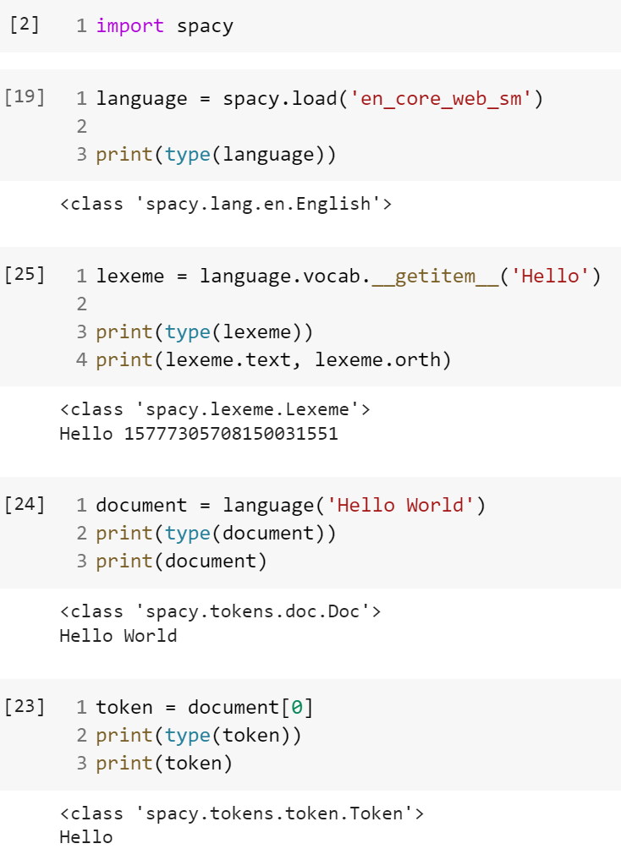
spaCy Documents
A spaCy Doc is a sequence of Token objects. The Vocab (of a Language) contains all Lexeme objects and other shared data.

Slide 23
Exercise 11 – Computing Basic Statistics
Write a script that generates the following statistics for a given search term and a set of text files (a corpus):
The absolute and relative frequencies; the mean frequency; the standard deviation. Also try to plot the frequency distribution across files.
Basic Approach
We define two functions for getting the absolute and relative frequencies of a given text. Then we are using a third function to generate frequencies for a number of texts which we will store in a list. Finally, we can use Python’s statistics functions to get the required statistics.
Pandas DataFrame Approach
After getting the vocabulary of the corpus, we use one of the functions from above to populate two frequency tables. Then we create Pandas DataFrames from these tables.

Slide 24
Lists and Sets
Sets, in the mathematical sense, are well-defined collections of distinct elements.
list_with_duplicate = [‘A’, ‘B’, ‘B’, ‘C’]
s = set(list_with_duplicate)
→ {‘A’, ‘B’, ‘C’}
In Python, sets are unordered and only contain unique elements.
While sets can be used for many things (especially when leveraging set theory), we will simply use them to turn a list of tokens (containing duplicates) into a set of types.

Slide 25
Vocabulary
In NLP it is very common to store the vocabulary (essentially a list/set of types) in a data structure separate from everything else. Aside from some other benefits, this avoids duplication and reduces memory cost. Here’s a very simplistic example:
Index | 0 | 1 | 2 | 3 | 4
vocabulary = | [‘the’, ‘grey’, ‘cat’, ‘is’, ‘black’]
v = vocabulary
sentence = [ v[0], v[2], v[3], v[4] ]

Slide 26
Vocabulary
In NLP it is very common to store the vocabulary (essentially a list/set of types) in a data structure separate from everything else. Aside from some other benefits, this avoids duplication and reduces memory cost. Here’s a very simplistic example:
Index | 0 | 1 | 2 | 3 | 4
vocabulary = | [‘the’, ‘grey’, ‘cat’, ‘is’, ‘black’]
Type vocabulary[i] | Frequency
0 | 2 | the
1 | 1 | grey
2 | 2 | cat
3 | 2 | is
4 | 1 | black
We can use the same vocabulary to index frequency tables.
document = ‘The cat is grey. The cat is black’
frequencies = {0: 2, 1: 1, 2: 2, 3: 2, 4: 1}

Slide 27
Exercise 12 – Basic Collocation Analysis
Write a function that allows you to find collocates of a given word in a given text file. If you want to do this from scratch, you will have to implement a collocation/association measure of your choice.
Node
NLTK Approach
We are using NLTK to generate “Collocations”. However, these collocations are somewhat different from what we are used to in CL.
5L | 4L | 3L | 2L | 1L | N | 1R | 2R | 3R | 4R | 5R
Window (Span)
From Scratch
We are implementing the ‘traditional’ approach to collocation using MI scores.
Which words (tokens) appear frequently within the node in the window?

Slide 28
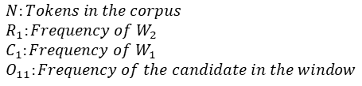
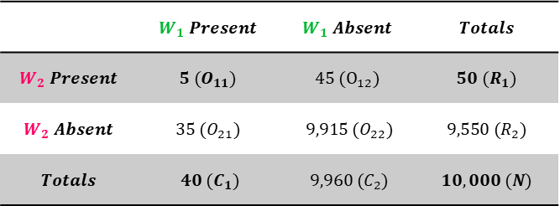

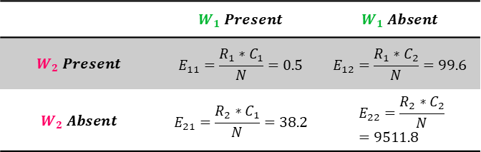
Basic Collocation Analysis
$$MI=\log_{2}{\frac{O_{11}}{E_{11}}=\log_{2}{\frac{5}{0.5}=10}}$$
Node
5L | 4L | 3L | 2L | 1L | N | 1R | 2R | 3R | 4R | 5R
W2 (Node) W1 (Candidate)
 | $$W_{1} Present$$ | $$W_{1} Absent$$ | $$Totals$$
$$W_{2} Present$$ | $$5 (O_{11})$$ | $$45 (O_{12})$$ | $$50 (R_{1})$$
$$W_{2} Absent$$ | $$35 (O_{21})$$ | $$9,915 (O_{22})$$ | $$9,550 (R_{2})$$
$$Totals$$ | $$40 (C_{1})$$ | $$9,960 (C_{2})$$ | $$10,000 (N)$$
Usually, we consider three things: a node word, a possible collocate (candidate), and a specific window.
Find all instances of node in the corpus
For each instance, count the appearances of the candidate in the given window
Calculate an MI (Mutual Information) score for the candidate
Repeat this process for all possible candidates (= every word in the vocabulary)
Report the ‘top’ candidates based on MI-score and frequency
 | $$W_{1} Present$$ | $$W_{1} Absent$$
$$W_{2} Present$$ | $$E_{11}=\frac{R_{1}∗C_{1}}{N}=0.5$$ | $$E_{12}=\frac{R_{1}∗C_{2}}{N}=99.6$$
$$W_{2} Absent$$ | $$E_{21}=\frac{R_{2}∗C_{1}}{N}=38.2$$ | $$E_{22}=\frac{R_{2}∗C_{2}}{N}=9511.8$$
$$N:Tokens in the corpus \\ R_{1}:Frequency of W_{2} \\ C_{1}:Frequency of W_{1} \\ O_{11}:Frequency of the candidate in the window$$

Slide 29
Exercise 13 – NLTK Stemming, Lemmatization, and WordNet
Use NLTK to stem and lemmatize the following words. Use the PorterStemmer, the LancasterStemmer, and the WordNetLemmatizer and compare your results. What are the pros and cons of these approaches?
words = ['connection', 'become', 'caring', 'are’, 'women', 'driving']
Of course, feel free to add more examples! Since you already have WordNet, try to find the synonyms for fantastic using WordNet.
Stemming and Lemmatizing
We are using NLTK to compare three stemmers and/or lemmatizers. After looking at them qualitatively, we are testing how fast they can lemmatize a large number of words.
WordNet Synsets
We are using NLTK to access WordNet data. More precisely, we are accessing the synsets for fantastic in order to find possible synonyms.

Slide 30
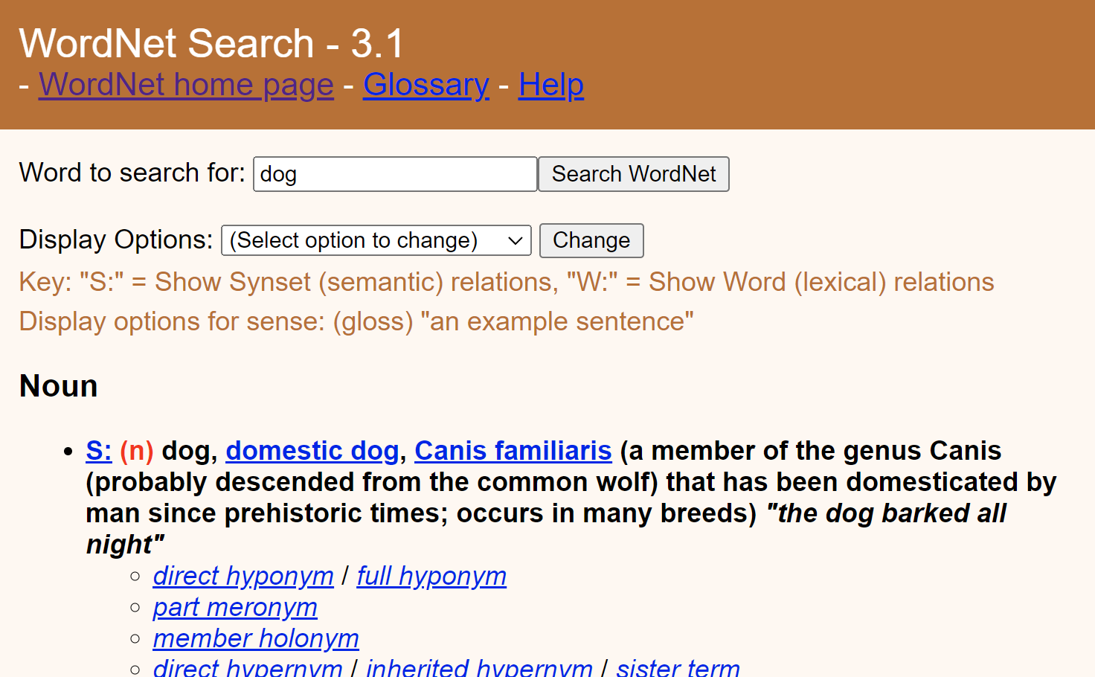
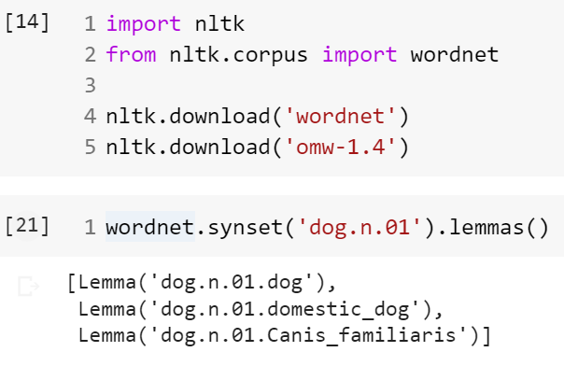
WordNet and Synsets
WordNet is a lexical database for English in which words “are grouped into sets of cognitive synonyms,” so-called synsets. These express distinct concepts.

Slide 31
Exercise 14 – spaCy Tagging
Use spaCy to automatically tag/annotate a text file of your choice for PoS, NERs, and Universal Dependencies.
Here we are using spaCy and a small language model (en_core_web_sm) to tag a given text. After creating a spaCy document – using the model – we can loop over the tokens (and entities) to access their tags.
Using displaCy, spaCy’s visualizer library, we can also generate graphs for the dependencies.

Slide 32
Exercise 15 – Parsing XML
Write a function that allows you to extract all elements with a given attribute from an XML file.
For example, the function should be able to produce the following output for the file data/xml/bnc_style.xml and the attribute pos="VERB": have, bought
RegEx-Based Approach
We are using a rather simple regular expression to find XML elements that contain the desired attribute and value. This solution, while being very straightforward, is not very robust if, for example, the underlying XML changes slightly.
Parsing Approach (LXML)
Here we are using an XML library (LXML) to parse and then navigate the XML structure/tree. We can also use XPath to navigate the document comfortably.

Slide 33
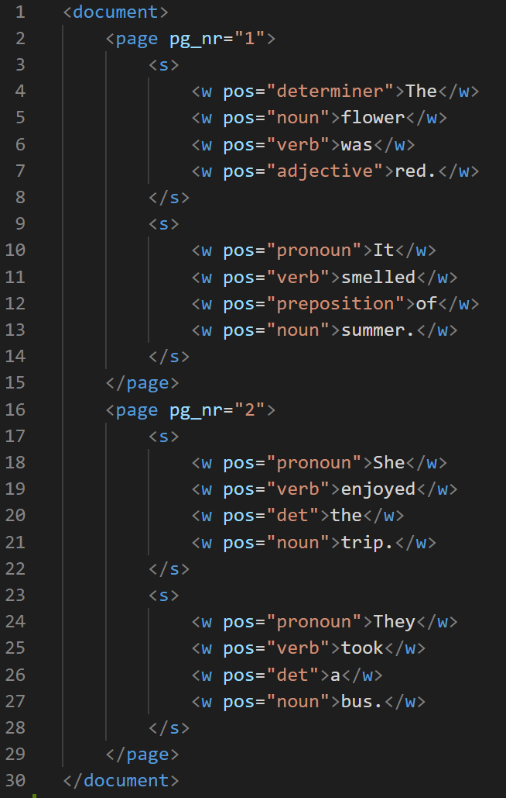
XML as a Tree
root
document
page
page
s
s
w
w
w
w
w
w
w
w
s
w
w
w
w
s
w
w
w
w
s[2]
w[1]

Slide 34
XML XPath
XPath is a query language used for selecting nodes in XML documents.
/page[@pg_nr='2']/s[2]/w[1]
/ Select from the root node
@ Select attribute
/page[@pg_nr='2']
/page[@pg_nr='2‘]/']/s[2]
s[2]
w[1]
/page[@pg_nr='2‘]/']/s[2]/w[1]

Slide 35
Exercise 16 – Web Scraping
Write a function that scrapes the text from a given website. The function should take a URL as its input and return the text present on the given website (e.g., Wikipedia). If you want to challenge yourself even further, try to remove boilerplate (everything that is not the main text) from the result.
HTML and BeautifulSoup Parsing
The first function will use requests to get the HTML for the article. We are then using BeautifulSoup to parse the HTML and only return the content of the bodyContent div of the Wikipedia article.
HTML and jusText
The second function also retrieves the HTML using requests. Instead of parsing the site ourselves, we are using jusText to identify non-boilerplate paragraphs which we then combine into one string.

Slide 36
HTTP GET and Requests
In order to retrieve a website, a client (e.g., a browser) sends an HTTP GET request to a webserver. The server then responds with the website by sending HTML and possibly other content/files such as images.
For example a browser or a Python script
For example Wikipedia’s webserver
Client
(1) HTTP GET
Server
(2)
Code 200
Content / Files
The server also sends a status code indicating whether the requests worked.
We can use the Requests library to send HTTP requests:
Code | Meaning
200 | OK
403 | Forbidden
404 | Not Found
5XX | Server Error
… | …
r = requests.get(‘https://en.wikipedia.org/wiki/Linguistics’)
r.status_code → 200
r.text → text/HTML
r.content → Binary/non-text content

Slide 37
Exercise 17 – Putting Everything Together (Keyword Analysis)
The ultimate goal of this exercise is to write a system which can perform basic (comparative) keyword analysis on two corpora.
Use your web scraper to build a small Wikipedia corpus of about three to five articles. Ideally, they will belong to a similar topic, e.g., politics.
Find a suitable reference corpus to compare your Wikipedia corpus with.
Use your new skills to generate frequency lists for both corpora.
Implement any keyness statistic (e.g., simple maths or log-likelihood) and determine the keywords.
Hint: To download the COCA sampler, run the following command in a Google Colab cell:
!cd python-programming-for-linguists/2020/data && sh download_coca.sh
This will download and extract the COCA sampler to your /data/corpora/coca folder.

Slide 38
Shared Vocabulary
For our comparative analysis, we need to be able to compare the frequencies for all types in both corpora. A reliable way of doing this is to use a shared vocabulary; alternatively, one could assign 0 if the type is not found in the other corpus during the comparison.
Target
Shared Vocabulary
Frequency Table
Type_A, Type_B
Type_A
Type_B
Type_C
Vocab | Target | Reference
Type_A | 4 | 3
Type_B | 6 | 0
Type_C | 0 | 7
…
Reference
Type_A, Type_C

Slide 39
Lambda Functions aka. Anonymous Functions
Lambda functions are very powerful but quite hard to comprehend. On the surface level, and we will not go any deeper, these are functions without a name. They are used when we only require a function for a short period of time.
x = lambda a: a + 10
x(5)
→ 15
We’re only going to use them once!
They are, for example, useful when .apply-ing functions to a DataFrame.

Slide 40

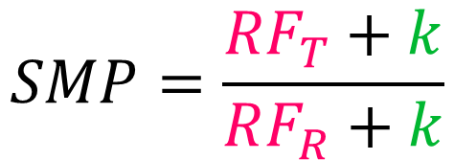

Simple Maths Parameter
The k parameter works almost as a filter. The lower we set the parameter, the more low-frequency items we will identify as keywords.
$$SMP=\frac{{RF}_{T}+k}{RF_{R}+k}$$
$$k=100$$
$$Relative Frequency$$
See Kilgarriff, Adam. (2009). Simple Maths for Keywords. In Proceedings of the Corpus Linguistics
Conference, Liverpool, July.

